Slide 1
Key features
DevKit-STM32L5

Slide 2
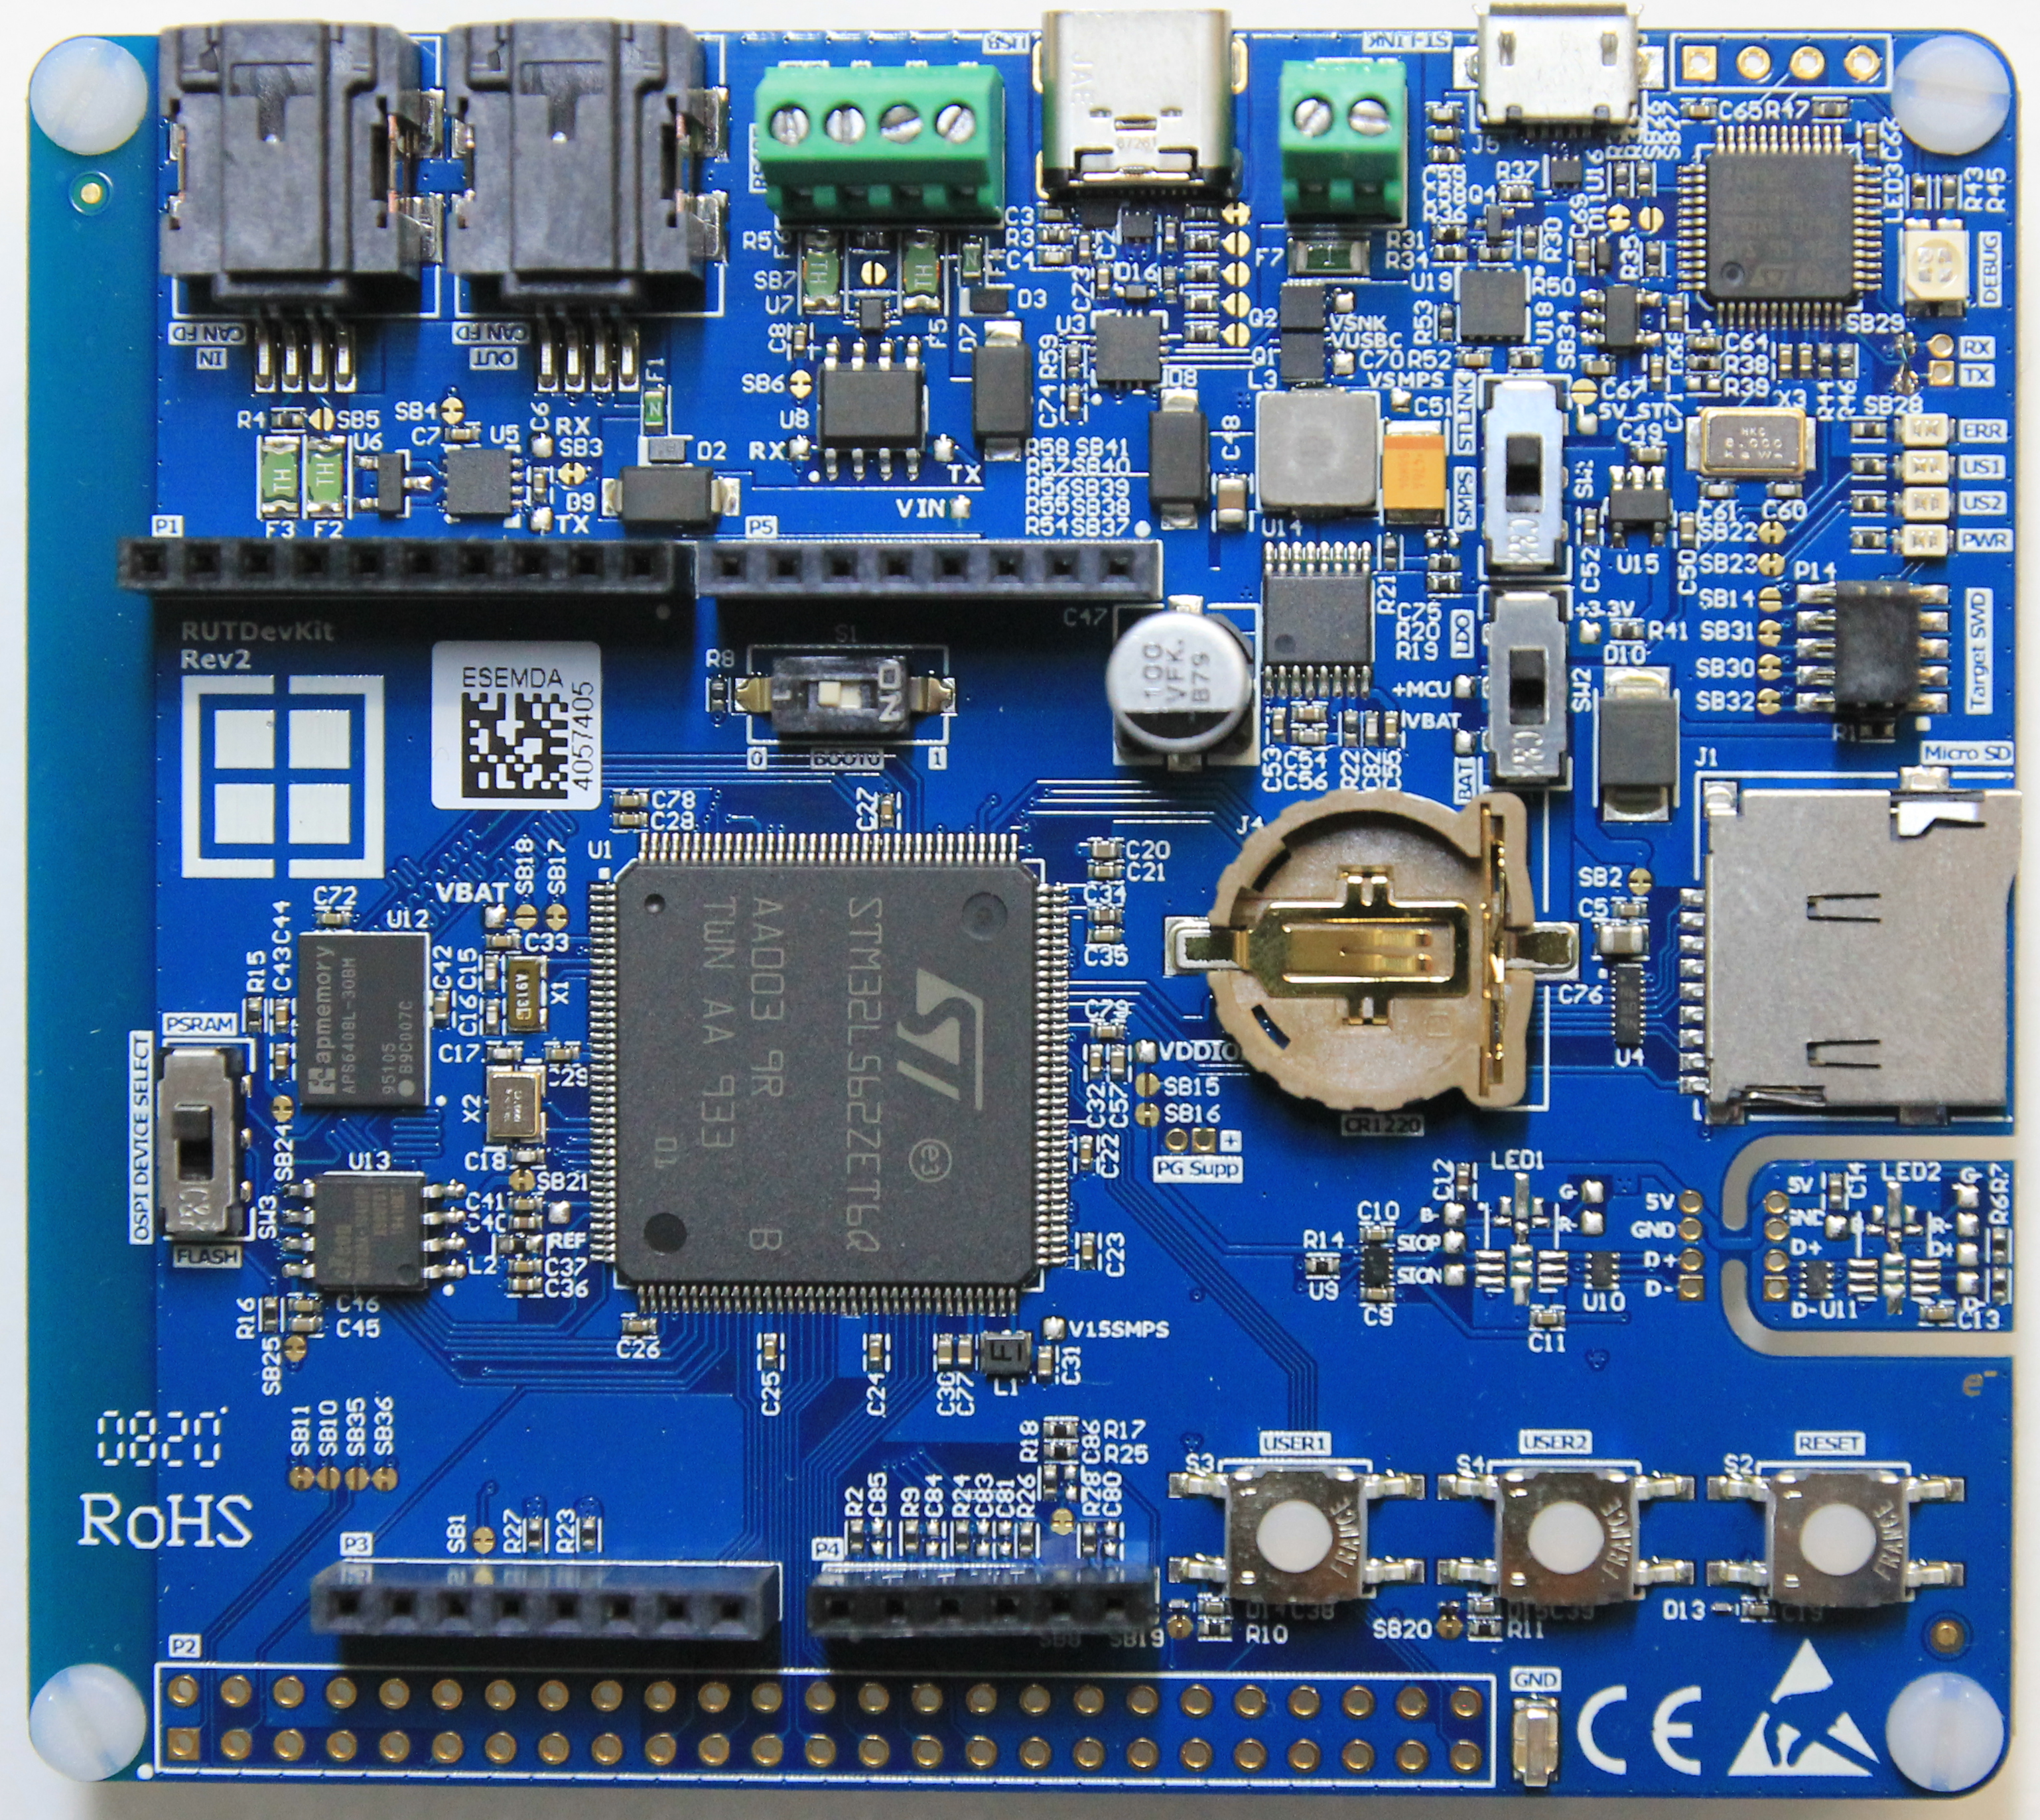
Table of Contents
Firmware examples and Support
TrustZone for Security
Low Power and Power Delivery
Memory placement and example
Arduino Connectivity

Slide 3
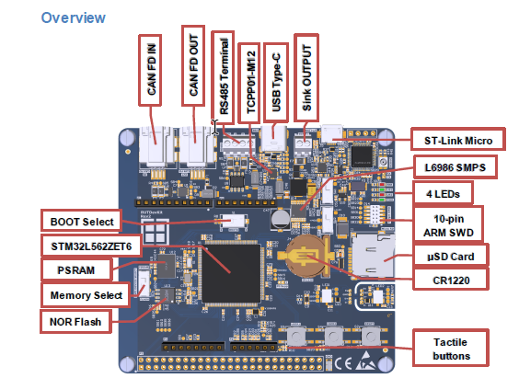
Firmware examples and Support
Faster development start through our examples
Access to all L5 hardware features for Evaluation
CAN-FD Test Modes Demo
RS485 Modbus Demo
USB Power Delivery Demo
Dual Bank Flash Bootloader Demo
TrustZone® Demo
Tamper Detection Demo
Help customers with
development projects and evaluation with our support engineers

Slide 4
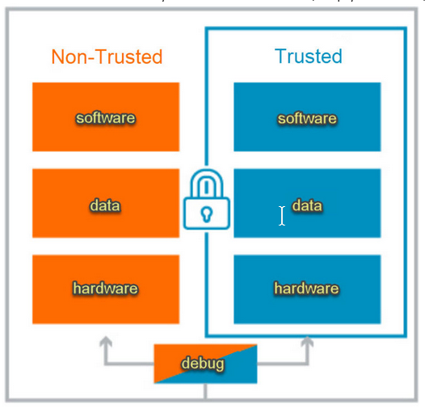
TrustZone for Security
Arm TrustZone embedded security options for the ARM Cortex-based processor systems
creates two environments that can run simultaneously on a single core: a safe world and a non-safe world

Slide 5
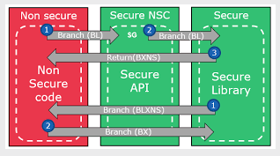
TrustZone for Security
Non secure and secure usage
example:
It is possible to store algorithms in the safe zone. Later, to program new applications and access the algorithms via application programming interfaces (API).
For example:
There are NSC (non secure callable) regions,where non secure application can call secure application functions

Slide 6
TrustZone for Security
In our RutDevKit-STM32L5
Secure and non Secure Zones
Secure Boot and non secure Boot

Slide 7
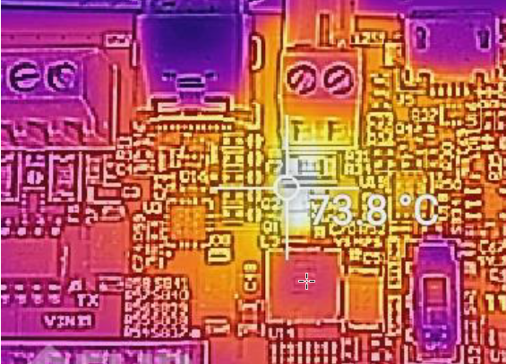
Low Power and Power Delivery
Low Power
1.71 V to 3.6 V power supply
-40 °C to 85/125 °C temperature range
Power Delivery
100 Watt USB-C delivery
14.87V drop on resistor with current
flow of 3.7A.
Application Example:
Power Bank
Printers, Cameras, IoT, Phones
Any Type-C sink device

Slide 8
Use of Momory example
RutdevKit-STM32L5 Memorys
Intern Secure Zones in L5
Extern Memory
OSPI PSRAM
QSPI NOR FLASH
Micro SD card Slot
Example intern memory: Block access to
external Memory
Example extern memory : Data storage
to be able to make a statement about the
Life expectancy of an engine

Slide 9
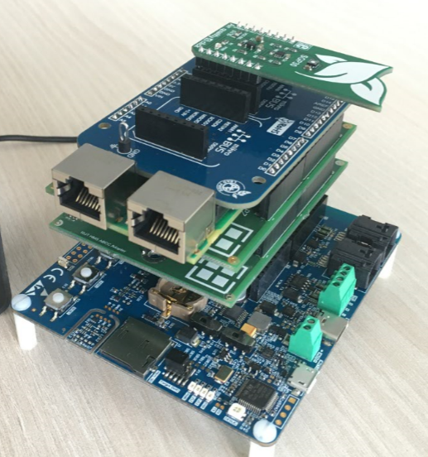
Arduino Connectivity
Arduino connection to realize a
wide range of applications
Example Picture

Slide 10
Gintaras Drukteinis & Albert Golek
Technical Support Engineers
Phone : +370 372 45568 , +49 7231 801 1741
eMail : gdr@rutronik.com , eMail : albert.golek@rutronik.com

